Slide 1

Fine-Tuning Explained From Zero to Training Your Own Model for Free (Unsloth)
Notes:
Finetuning from 0 to finetuning your model for free with the simplest way (Unsloth)

Slide 2
Overview
In this video:
1. Introduction
3. Fine-Tuning Explained
4. Coding
-Fine-Tune Llama3.2 (1B) with UnSloth
-Save and use the model using Ollama

Slide 3
Introduction
I

Slide 4
What is “Fine-Tuning"?
The process of taking a pretrained (language) model and training it further on a specific dataset, usually to adapt it to a specific task, domain, or tone.

Slide 5
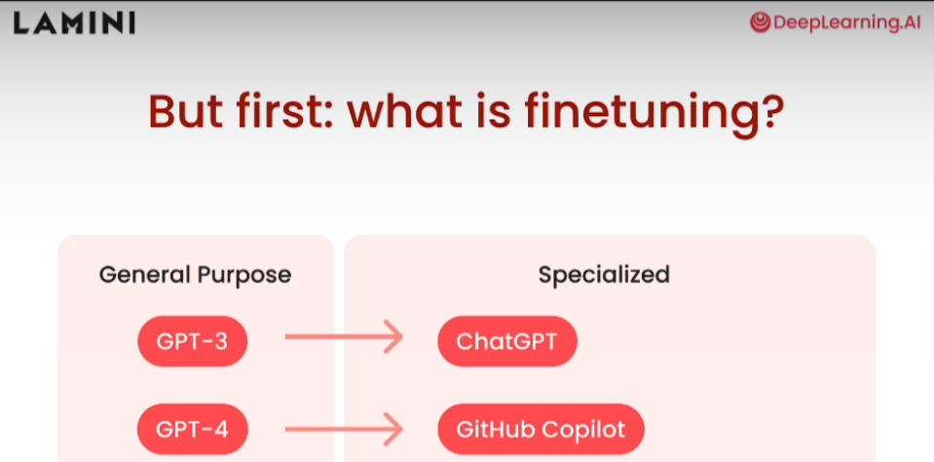
Notes:
PCP -> Primary Care Physician

Slide 6
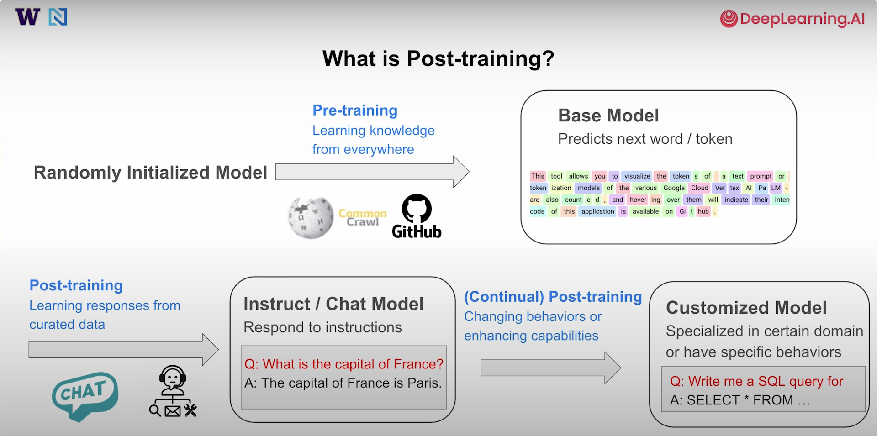

Slide 7
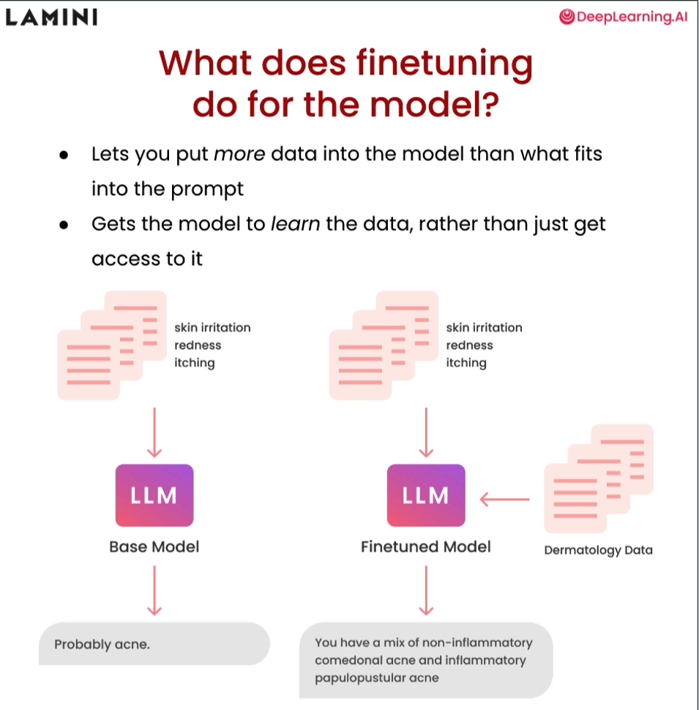
Back

Slide 8
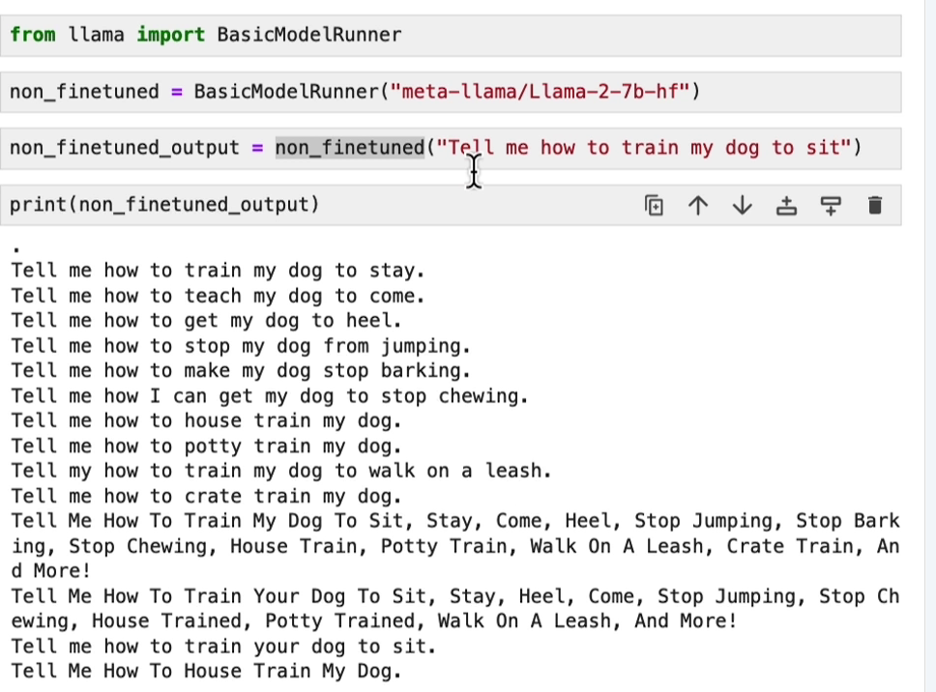

Slide 9
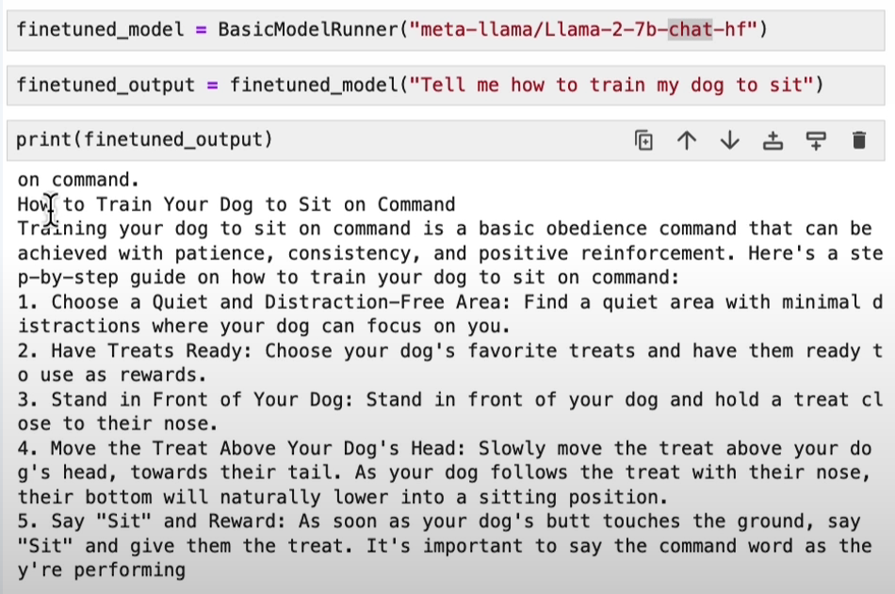

Slide 10
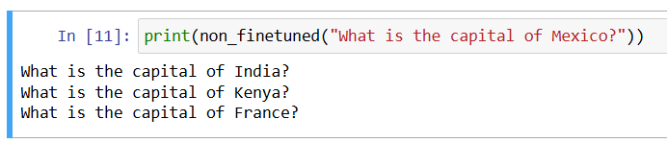

Slide 11
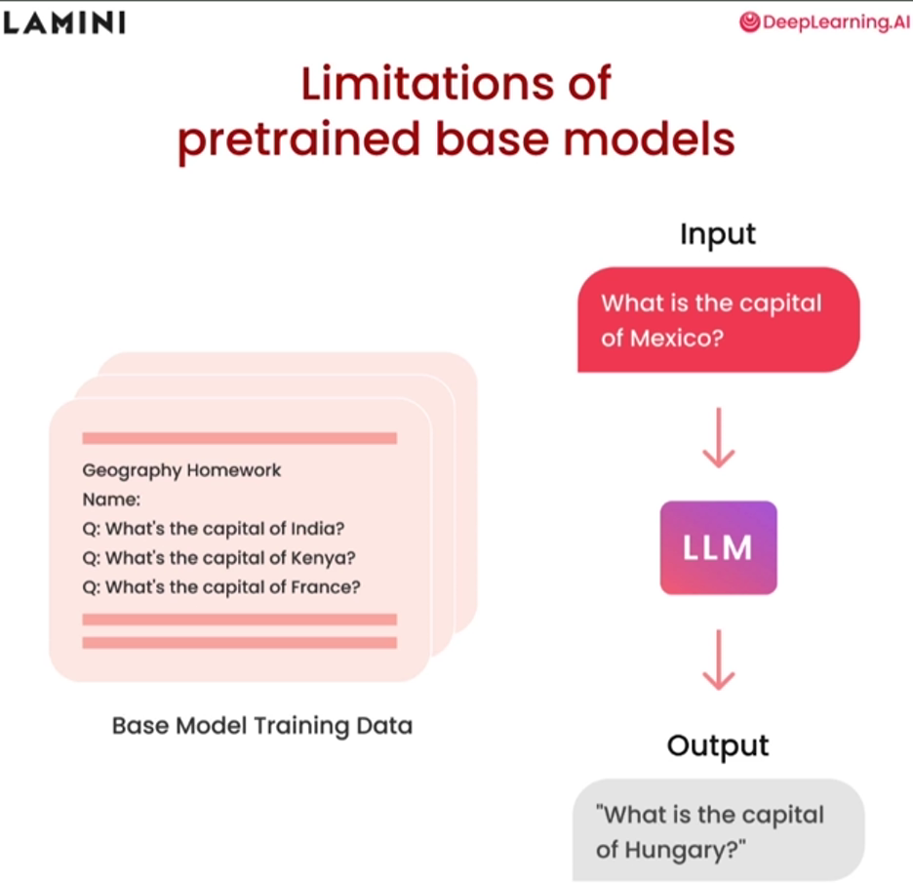

Slide 12
Why "Fine-Tuning"?
Fine-tuning customizes a pretrained LLM to perform better on specific tasks or domains by training it on targeted data. It improves performance, privacy, cost and reliability

Slide 13
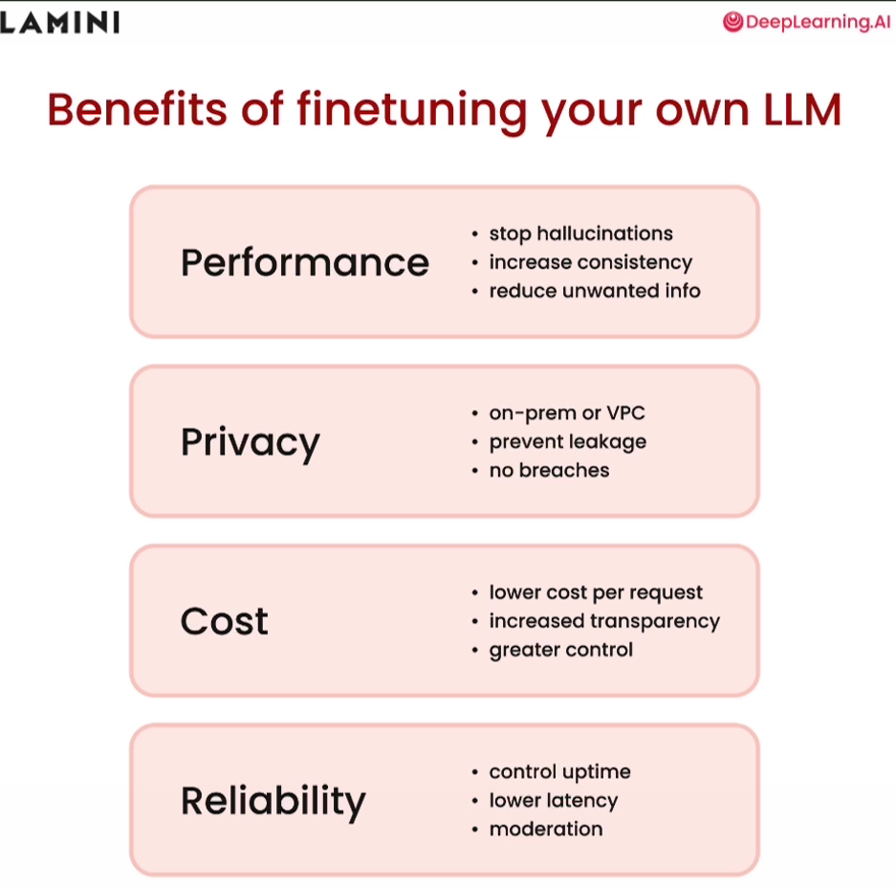

Slide 14
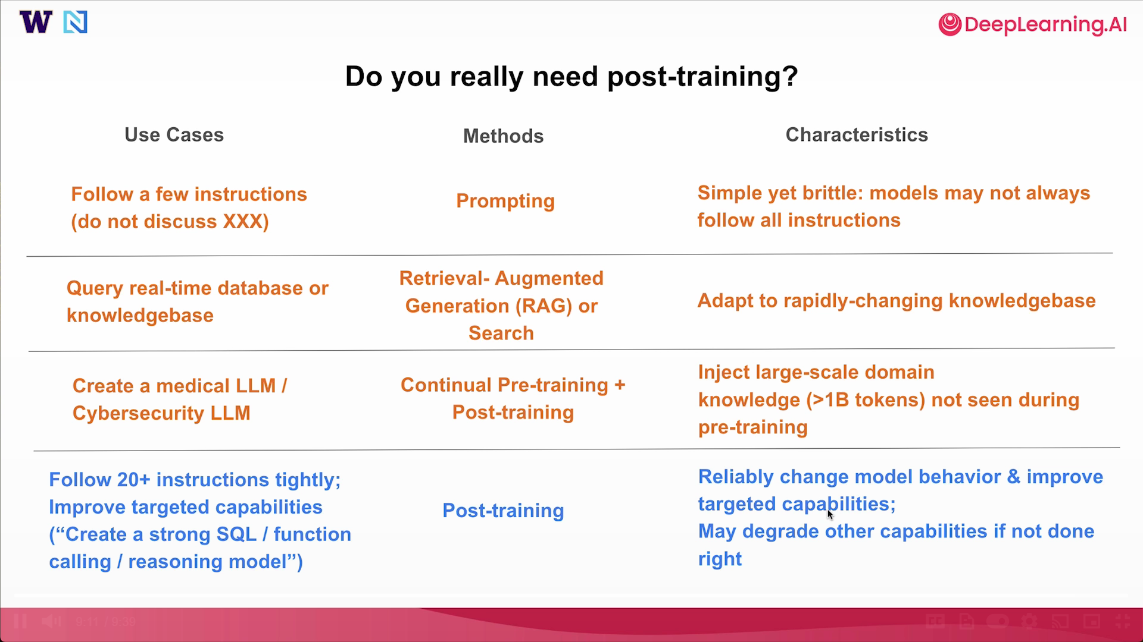

Slide 15
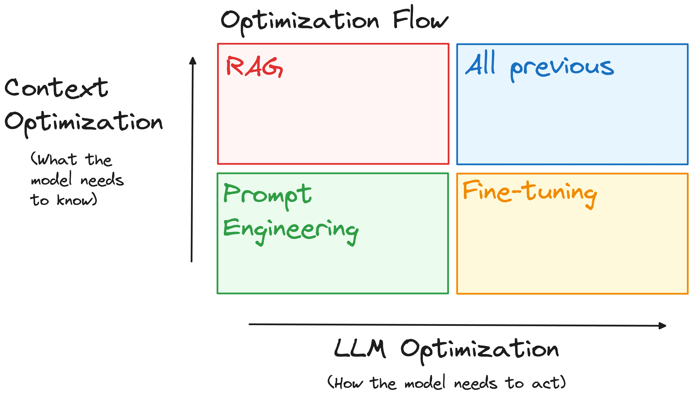

Slide 16
Other Techniques for Optimizing LLMs
1. Fine-tuning & Training Approaches
SFT (Supervised Fine-Tuning)
DPO (Direct Preference Optimization)
PPO (Proximal Policy Optimization)
GRPO (Group Relative Policy Optimization)
RLO (Reinforcement Learning from Observation)
RLHF (Reinforcement Learning from Human Feedback)
Model Distillation or CompressionMOE (Mixture of Experts)
2. Prompt-based Techniques
Prompt Engineering
Prompt Tuning
Prefix Tuning
Chain of Thought (CoT)
Zero-shot Learning
Few-shot Learning
LLM Chaining
3. Retrieval & External Knowledge Integration
RAG (Retrieval-Augmented Generation)
Tool Use / Function Calling
4. System & Architecture Modifications
System Architecture Modifications
MOE (Mixture of Experince)
5. Data Processing & Evaluation
Data Preprocessing & Output Postprocessing
Evaluation & Feedback Loops

Slide 17
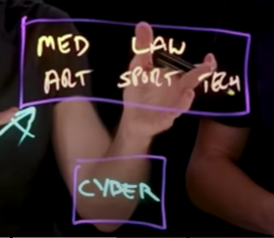
A large model with broad domain knowledge is less likely to hallucinate when answering general questions, whereas a smaller, more specialized model is more likely to hallucinate when the question doesn’t fall within its specific area of expertise.
A large model with broad domain knowledge is more likely to hallucinate when answering domain-specific questions, whereas a smaller, specialized model is less likely to hallucinate when the question falls within its area of expertise.
Choose the right model for the right purpose.
Notes:
it has more area to hallucinate across.

Slide 18
Finetuning Workflow
2

Slide 19
Step-by-Step Fine-Tuning Workflow
0. Identify your goal with respect to your resources
Choose the Model
Choose a Trainer Library That Supports This Model
Use the Tokenizer That Matches the Model
Format Your Data the Way the Tokenizer/Trainer Expects

Slide 20
0- Identify your goal with respect to your resources
Before choosing a model or trainer, ask:
What is your fine-tuning goal?
What are your hardware/resources?
☁️ Cloud:
🆓 Free options (e.g., Kaggle, Google Colab)
💰 Paid options (AWS, GCP, Azure, Google Colab Pro)
🖥️ On-Premise (Offline / Local Machine):
🎮 GPU, 📦 VRAM, 🧠 RAM, 💾 Disk space, 🖥️ CPU
What is your dataset size and format?

Slide 21
1- Choose the Model
🔓 Open-Source Models
Model Size (e.g., 1B, 2B, 7B, 27B, 70B)
Model types (e.g., "instruct", "chat", "coder")
Quantization formats (e.g., "INT4 (4-bit quantization)", "GGUF")
Languages or regional variants (e.g., "PT-BR", "E08")
Source/model tags (e.g., "hf", "fb", "E2B")
🔒 Closed-Source Models
Some of them can be finetuned through API-only (no control over training internals)
You pay per training & usage token
Great for high-level training

Slide 22
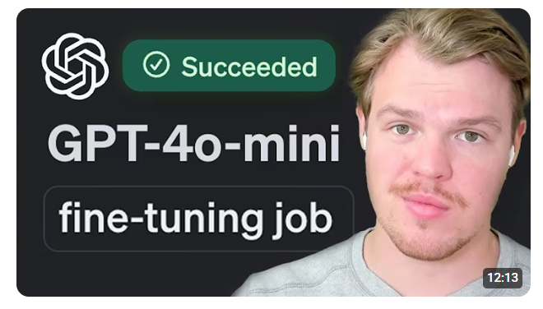
Fine-tuning ChatGPT with OpenAI Tutorial –
[Customize a model for your application in 12 Minutes]

Slide 23
2- Choose a Trainer Library That Supports This Model
Choose a Trainer Library That Supports This Model
(e.g., Unsloth, transformers.Trainer, trl.SFTTrainer, Axolotl)
Choose based on:
Model type and architecture
If the model is supported by a specialized optimized library (like Unsloth for LLaMA)→ Use it unless you need a feature it doesn’t support (e.g., maximum customization → Hugging Face Transformers + PEFT)
2. Hardware availability
Some libraries are built for speed and efficiency on specific hardware
(RAM/VRAM limits, Multi-GPU / high-end clusters, TPU support )
3. Data processing needs
e.g., Unsloth doesn’t have built-in support for non-text modalities (images, audio) like multimodal frameworks
4. Workflow goals
Research / experimentation, Fast, minimal-code fine-tuning, Enterprise deployment , Quantized training
Notes:
Tensor Processing Unit
1. Model type and architecture
Different libraries are better suited for certain model families.
Hugging Face Transformers + PEFT → best for mainstream LLaMA, Mistral, Falcon, BERT, T5, etc. Very flexible, lots of examples, integrates well with LoRA/Q-LoRA.
Unsloth → optimized for LLaMA/Mistral fine-tuning in minimal GPU memory (often 2–3× faster, lower VRAM). Ideal if you’re on Kaggle, Colab, or limited GPUs.
OpenAI fine-tuning API → for OpenAI’s hosted models (e.g., GPT-3.5 Turbo). Limited control but no infra setup.
vLLM + LoRA frameworks → if you want to deploy fast inference after training with optimized serving.
2. Hardware availability
Some libraries are built for speed and efficiency on specific hardware:
Low GPU memory (<16 GB) → Unsloth, PEFT, or DeepSpeed-ZeRO Stage 3 with LoRA.
Multi-GPU / high-end clusters → DeepSpeed, Megatron-LM, or Hugging Face Trainer with distributed training.
TPU support → Hugging Face with PyTorch-XLA, or JAX-based frameworks like Flax.
3. Data processing needs
Your dataset format and complexity matter:
Simple text data → Hugging Face Datasets or Unsloth (loads directly from text).
Custom formats / multimodal → Hugging Face (with custom collators), OpenFlamingo for vision-language.
Streaming large datasets → Hugging Face Datasets streaming mode or WebDataset.
4. Workflow goals
Research / experimentation → Hugging Face Transformers (flexible, modular).
Fast, minimal-code fine-tuning → Unsloth, OpenAI fine-tuning API.
Enterprise deployment → DeepSpeed + Hugging Face for distributed training and vLLM/Triton for serving.
Quantized training → PEFT Q-LoRA or Unsloth for training in 4-bit/8-bit.
Decision flow
Is your model supported by a specialized optimized library (like Unsloth for LLaMA)? → Use it unless you need a feature it doesn’t support.
Do you need maximum customization? → Hugging Face Transformers + PEFT.
Are you compute-limited? → Choose libraries with memory-efficient adapters (Unsloth, Q-LoRA, bitsandbytes).
Are you targeting production at scale? → Consider training with DeepSpeed and serving with vLLM.
If you want, I can make you a library comparison table showing when to pick Hugging Face, Unsloth, DeepSpeed, or others based on these factors. That way you can just follow it like a checklist.

Slide 24
3- Use the Tokenizer That Matches the Model
Choosing a tokenizer for fine-tuning is mostly about matching the model’s expectations and ensuring your data is represented efficiently.
Always start with the tokenizer that was used to pretrain the base model.
Example: If your model is LLaMA-3-8B, use its provided tokenizer
(e.g., LlamaTokenizerFast).
Either use the model’s original tokenizer or start from scratch, since you can’t use a pretrained model with a different tokenizer.

Slide 25
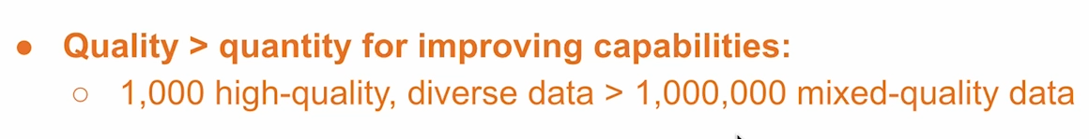
4- Format Your Data
Format Your Data the Way the Tokenizer/Trainer Expects
This depends on:
* The tokenizer’s expected input style:
* `{"role": ..., "content": ...}` → for HuggingFace’s ChatML format
* `{"from": ..., "value": ...}` → for Meta-style format (if not using HF tokenizer)
You can use`apply_chat_template()` or a manual formatting

Slide 26
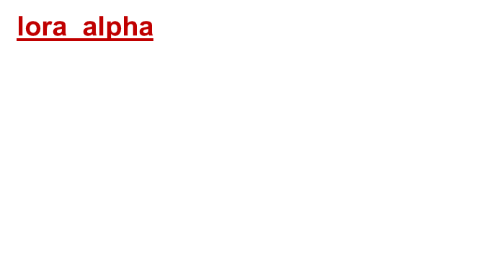
Model & Tokenizer
max_seq_length → I/P + O/P tokens
Load_in_4bit → stores weights using only 4 bits per value (instead of 32), reducing memory usage by up to 8x.
dtype
I/P(prompt) → tokenized into integers (tokens IDs) → convert into Embeddings processed in model using dtype
The best dtype to use depends on the GPU architecture
LoRA
rank → Controls Number of trainable parameters,
Bigger r → more trainable
lora_dropout→Regularization Technique
How much random deactivation (dropout) is applied to the LoRA layers during training.
Randomly ignoring some neurons during training.
It’s like saying: “don’t let the model rely too much on any one path.”
0 means all LoRA layers are fully active during training. (faster)
use_gradient_checkpointing → recomputes output during backpropagation, saving memory.
target_modules → layers inside the model where LoRA will be applied
random_state → fixed random seed, to get repeatable results every time
lora_alpha → Controls the impact of the LoRA-trained layers on the model’s output.
Scaling factor = $\frac{rank}{lora_alpha}$
lora_alpha = r → full influence
r > → boost lora_alpha > →reduction
use_rslora→rank stabilized LoRA
bias →
neuron output = weight × input + bias
"none" -> makes training faster and uses less memory
loftq_config → Low-Rank Optimization for Quantized weights, a technique that improves training performance on quantized models (4-bit)
Notes:
LoRA fine-tuning with Quantization
#Drawback: Higher memory usage, Slower training, More complexity, Less community adoption

Slide 27
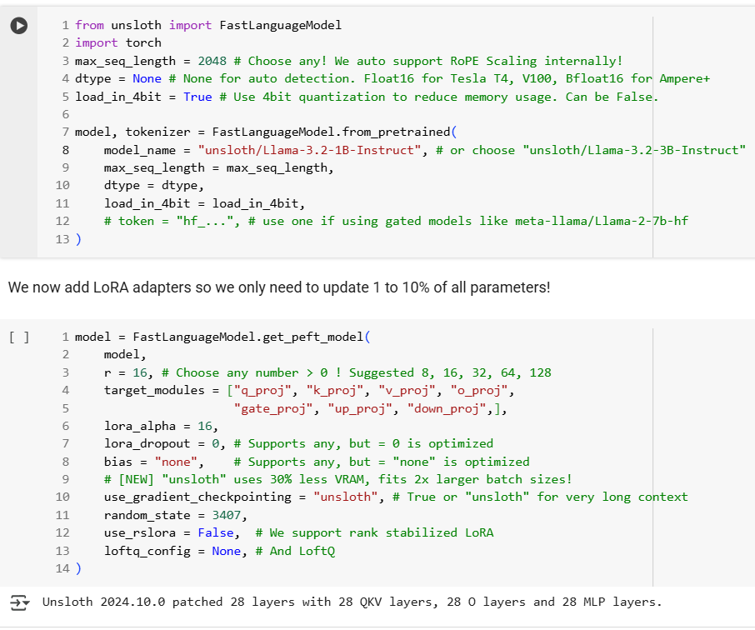
Back
Notes:
That function internally handles loading both the model weights and the tokenizer artifacts

Slide 28
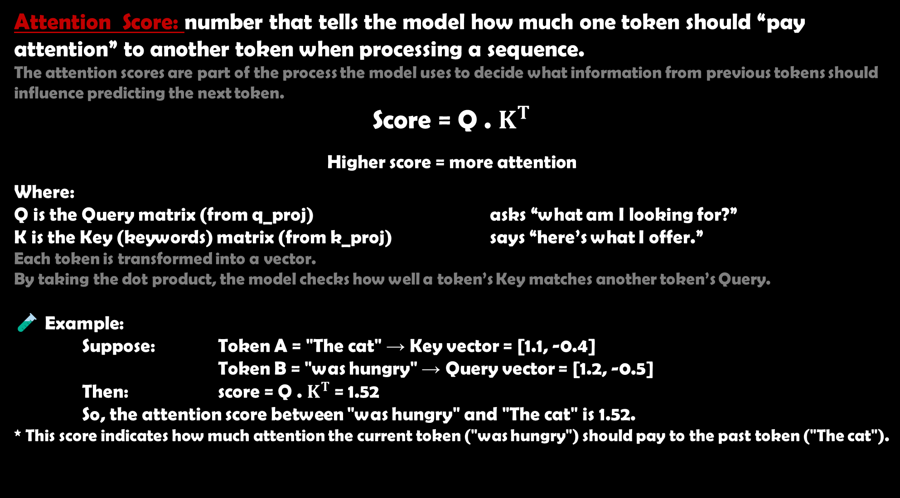
attention score
Attention Score: number that tells the model how much one token should “pay attention” to another token when processing a sequence.
The attention scores are part of the process the model uses to decide what information from previous tokens should influence predicting the next token.
Score = Q . $K^{T}$
Higher score = more attention
Where:
Q is the Query matrix (from q_proj) asks “what am I looking for?”
K is the Key (keywords) matrix (from k_proj) says “here’s what I offer.”
Each token is transformed into a vector.
By taking the dot product, the model checks how well a token’s Key matches another token’s Query.
🧪 Example:
Suppose: Token A = "The cat" → Key vector = [1.1, -0.4]
Token B = "was hungry" → Query vector = [1.2, -0.5]
Then: score = Q . $K^{T}$= 1.52
So, the attention score between "was hungry" and "The cat" is 1.52.
* This score indicates how much attention the current token ("was hungry") should pay to the past token ("The cat").
Back
Notes:
query projection
Q (Query) — from q_proj — represents what each token is looking for in other tokens.
K (Key) — from k_proj — represents what each token offers about itself, like its identifying features.

Slide 29
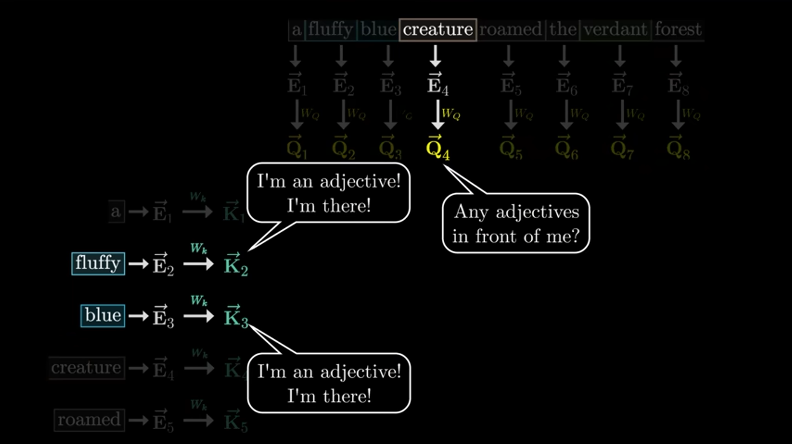
The model isn’t storing or asking an actual text question like “Any adjectives Infront of me”.
That’s just a human-friendly analogy to explain what the query vector represents.
What’s really happening is that the Q vector is compared to K vectors via a dot product to measure similarity.
If a Q matches a K well, it means “these two tokens are related in the way the model has learned during training,” not that it literally thought in words.
Back

Slide 30
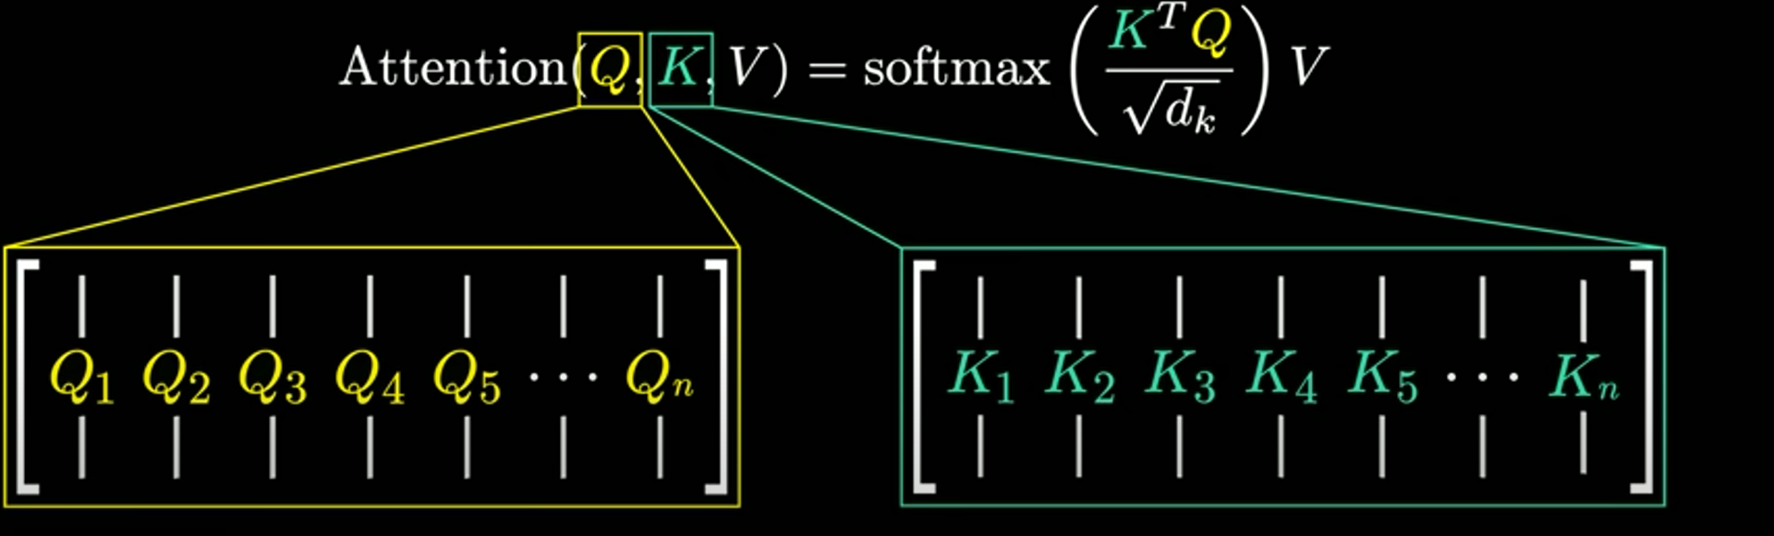
dk = dimension in that key-query space
* All attention scores are computed for all token pairs and passed through a SoftMax function, turning them into probabilities (weights).
* These weights are then used to combine Value vectors (from `v_proj`) to produce the final output.
Back
Notes:
Softmax to normalize the values
Dk for numerical stability (dimension of the key query space)

Slide 31
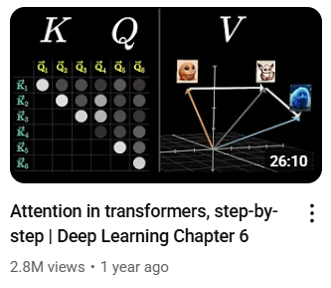

Attention in transformers, step-by-step | Deep Learning Chapter 6 3Blue1Brown
Back

Slide 32
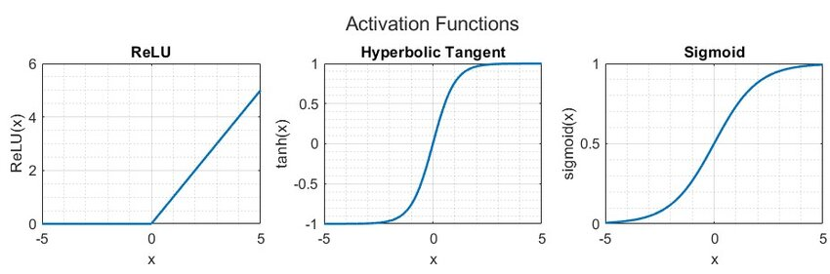
Bias
Bias is a small extra value added to each neuron’s output.
It helps the model shift activations and learn better.
Bias terms are trainable just like weights.
neuron output = weight × input + bias
This makes the neuron more flexible — it can shift the activation curve left or right (for sigmoids, tanh) or up and down (for ReLU).
𝑦=step(𝑊⋅𝑥+𝑏)
If 𝑏=0, the neuron activates exactly when 𝑊⋅𝑥>0
If 𝑏=−2, the neuron activates only when 𝑊⋅𝑥>2.
If 𝑏=+2, it activates even earlier, at 𝑊⋅𝑥>−2

Slide 33
Bias
`bias="none“`
(default in Unsloth): No new bias terms.
Most memory efficient and fastest.
Works fine because the base model already has biases trained during pretraining.
`bias="all“`
You also fine-tune the biases of the frozen model layers.
Slightly better adaptation for small domain shifts.
Costs more VRAM and makes merging harder.
`bias="lora_only“`
Adds bias only to LoRA layers, not the whole model.
A middle ground.
Back

Slide 34
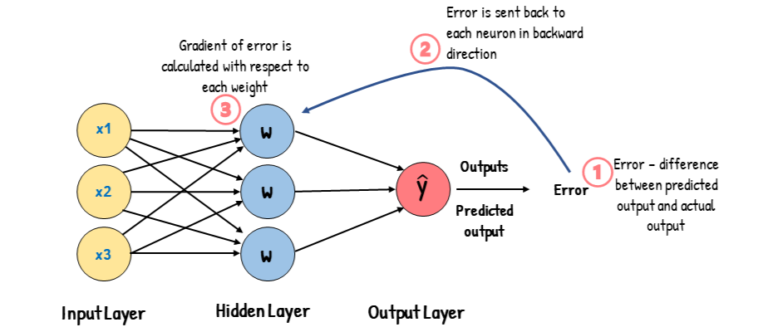
Backpropagation
Backpropagation is the process where the gradient of the error (loss) is calculated for each parameter in the model.
| Step | What happens
| ---------------------- | ------------------------------------------------------------------
| Forward pass | Model turns input into output (logits → probabilities via Softmax)
| Loss calculation | Compares prediction to the real answer (e.g. "cat" vs "dog")
| Backpropagation | Calculates how much each neuron/layer caused the error
| Optimizer step | Adjusts weights to do better next time
Back

Slide 35
RSLORA -> Rank-Stabilized LoRA
The issue with normal LoRA at high rank:
At low rank (small r), it is efficient and stable.
But at high rank (large r), two problems show up:
Training instability — updates can explode or vanish.
Redundancy — many of the extra rank dimensions don’t meaningfully help.
The key idea is:
instead of just randomly initializing A and B, it uses a better distribution and scaling that guarantees the magnitude of updates doesn’t grow (or shrink) with rank.
Drawbacks:
Extra complexity, overhead, Less tested.
Not always necessary: If your rank is modest (say 8–64), plain LoRA is already stable. RS-LoRA mainly helps when pushing very high ranks (128, 256+).
Back

Slide 36
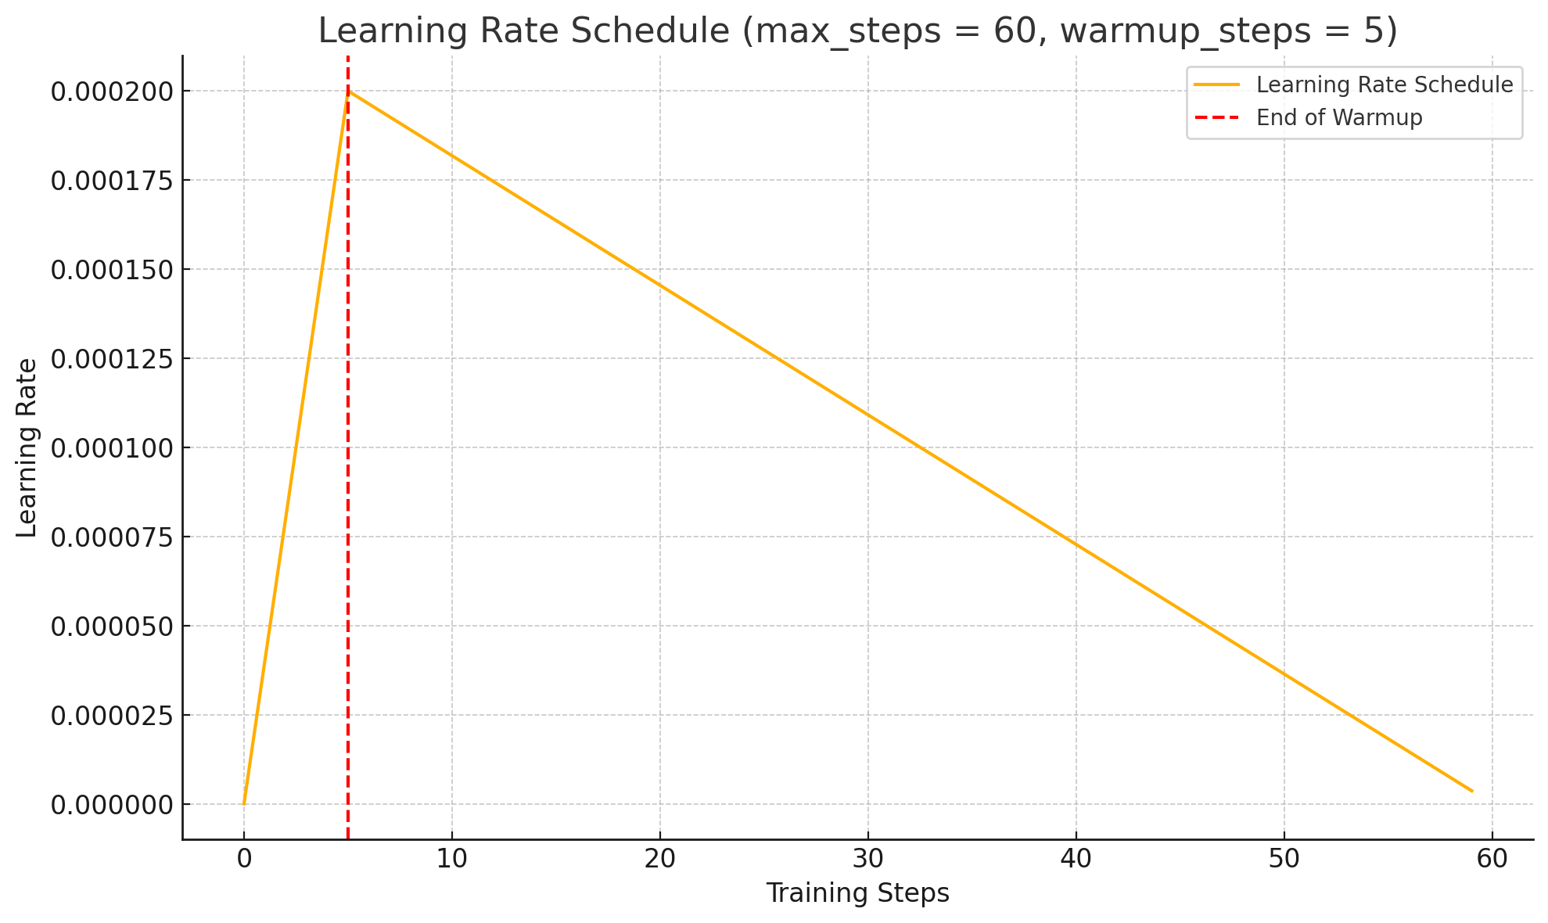

Trainer Setup
total_examples = max_steps × gradient_accumulation_steps × per_device_train_batch_size × num_gpus
model, tokenizer, train_dataset,
dataset_text_field, max_seq_length
data_collector → Prepare uniform size (tokenized) batches
- Speed (parallel computation)
- Stable Learning
LLaMA is not a Seq2Seq (encoder/decoder) model; it is a decoder-only, auto-regressive model.
We use DataCollatorForSeq2Seq simply because it has the right padding and label logic that happens to work for LLaMA.
per_device_train_batch_size→ Number of samples (examples) per device (per GPU or CPU(if no GPU)) per step.
max_steps
warmup_steps
data collator prepares batches, each batch contains per_device_train_batch_size
learning_rate
lr_scheduler_type = "linear"
dataset_num_proc → number of processes (CPU cores) to use for parallelizing the dataset processing (tokenization).
gradient_accumulation_steps
After this number of (mini) steps, do one optimizer step (update)
(apply gradients to update weights)
packing→ instead of wasting space with <pad>, we pack more than one short example into a single input.
Pros: Maximize GPU usage, Speed up.
Cons: More Complex Preprocessing, Unnecessary overhead if sequences are already long.
optim = "adamw_8bit“
Adaptive Moment Estimation
+ weight decay,
implemented in 8-bit precision
weight_decay
$w_{t+1}$ = $w_{t}$ - $η$ . $λ$ . $w_{t}$
optimizer’s weight decay update rule.
Notes:
1. Start-> gradient_accumulation_steps
2. gradient_accumulation_steps ->graph
3. graph -> End
Decoder-only, auto-regressive model = A model that has only a Transformer decoder stack, and generates text by predicting the next token step by step, conditioned on everything seen so far.
💡 Contrast:
Seq2seq (encoder–decoder): Encoder reads input (like English sentence), decoder generates output (like French translation).
implemented in 8-bit precision
It stores Adam’s moment estimates (m, v) in 8-bit precision instead of 32-bit floats, reducing GPU memory usage.
optimizer’s weight decay update rule.

Slide 37
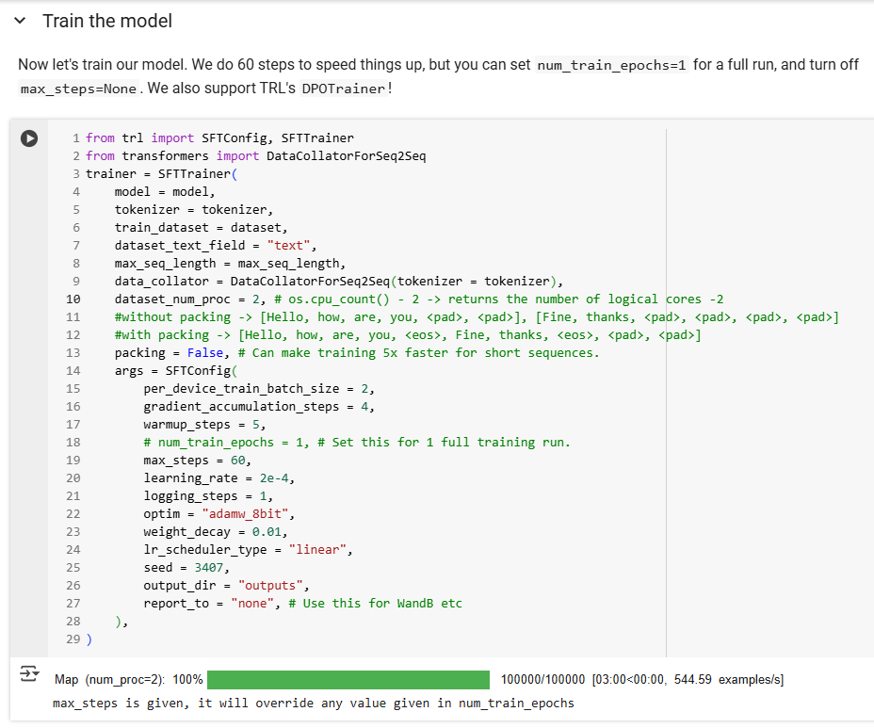
Back
Notes:
Sets the random seed for reproducibility. It ensures that operations like:(weight initialization, shuffling, dropout, data sampling) behave the same way every time we run the training script.
output_dir = "outputs", #where to save the model checkpoints and logs.
report_to = "none", # Use this for WandB (Weights & Biases) etc # choose what logs to be shown, if none it only shows the Step and Training Loss

Slide 38
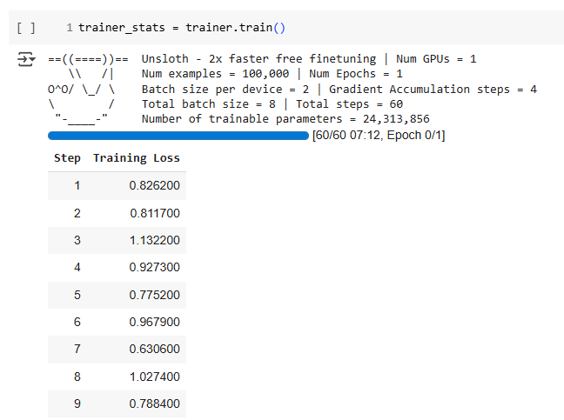
Back

Slide 39
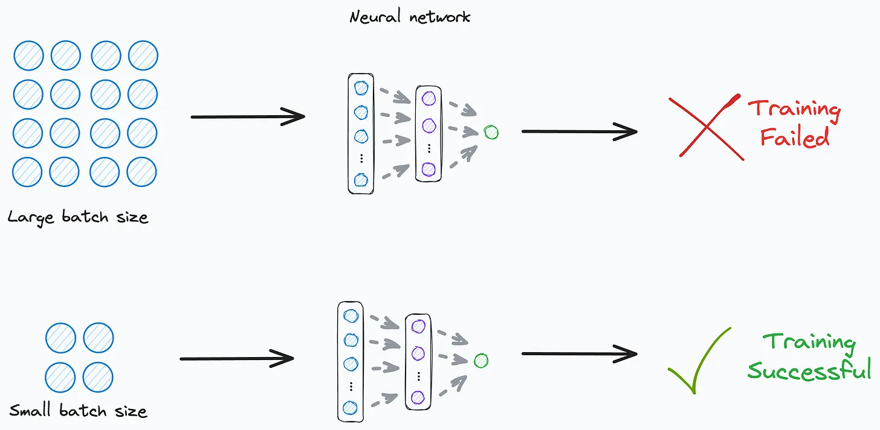
Gradient Accumulation
Under memory constraints, it is always recommended to train the neural network with a small batch size.
Back

Slide 40
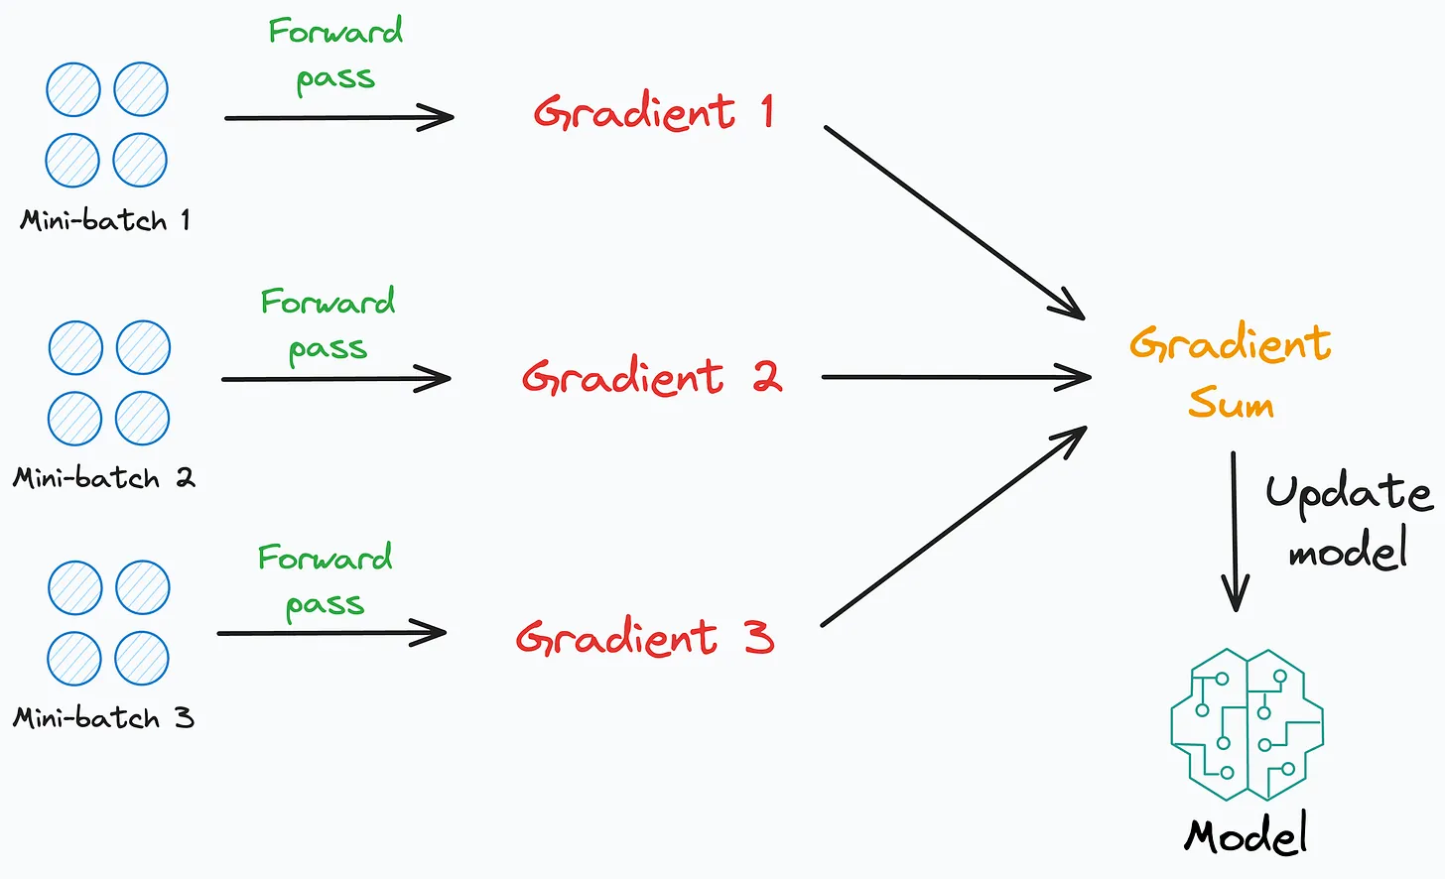
Gradient Accumulation
Back
Notes:
Why do neural networks typically explode during training?
The primary memory overhead in a neural network comes from backpropagation. This is because, during backpropagation, we must store the layer activations in memory. After all, they are used to compute the gradients

Slide 41
Why Do Batches Lead to More Stable Learning?
What happens during training?
Training a model means adjusting its internal weights to reduce loss — which measures how wrong the model's prediction was.
If you use 1 sample at a time, each update depends heavily on that one example, which might be noisy or unusual.
Single sample = unstable learning - Each example may be noisy or unrepresentative - Model overreacts to one data point → erratic weight updates
Batch = average of multiple examples - Loss is averaged across the batch - Model sees a more reliable training signal
Result: - Smoother loss curve - More consistent weight updates - Faster convergence & better generalization
Back

Slide 42
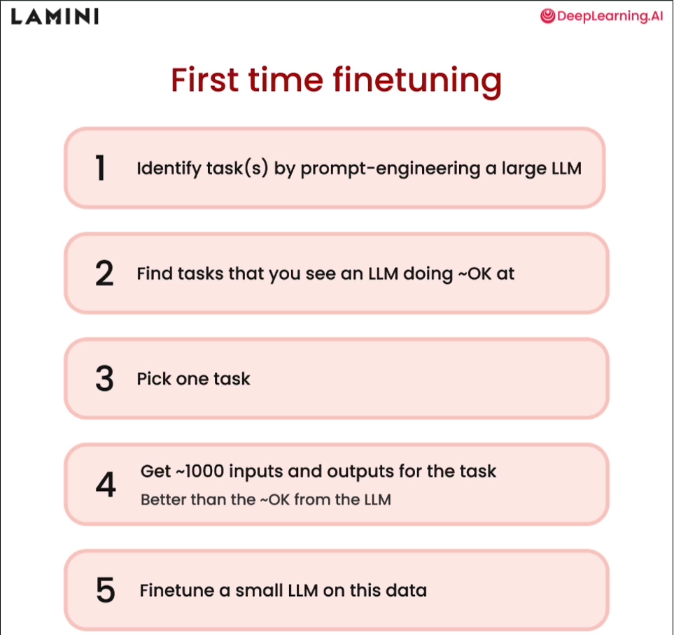

Slide 43
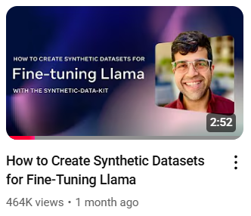
How to Create Synthetic Datasets for Fine-Tuning Llama

Slide 44
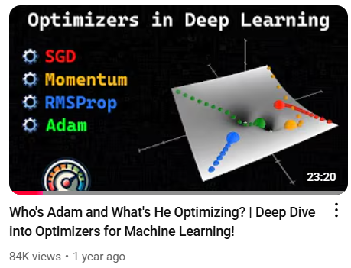
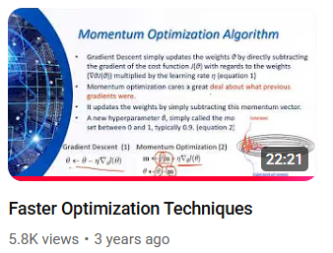
Who's Adam and What's He Optimizing? | Deep Dive into Optimizers for Machine Learning!
Faster Optimization Techniques
Back

Slide 45

The learning rate (LR): is a hyperparameter that controls how big each step of the optimizer is when updating the weights.
In early training, the model is far from the optimal weights,
it needs big steps to explore and learn fast.
Later, it gets closer to a good solution,
now it needs smaller, careful steps to avoid overshooting or bouncing around.
Back
Notes:
2e-4 = 2 × 10⁻⁴ = 0.0002Training Loss
learning rate scheduling (or learning rate annealing/decay).
The learning rate (LR) is a hyperparameter that controls how big each step of the optimizer is when updating the weights.

Slide 46
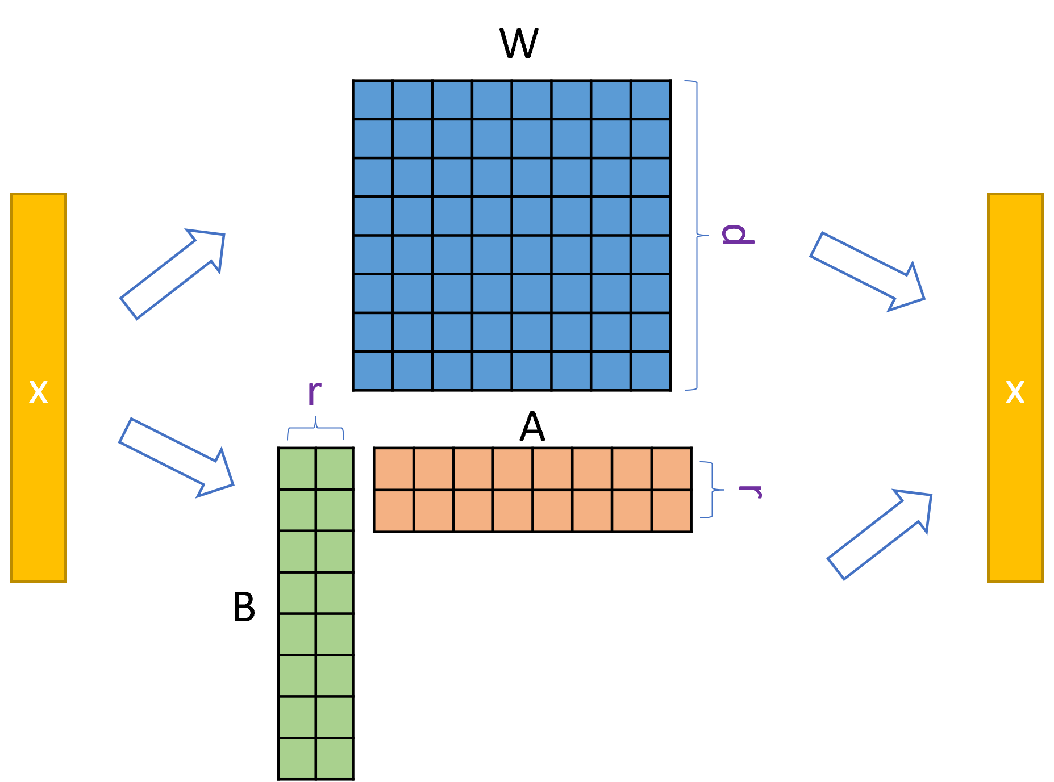
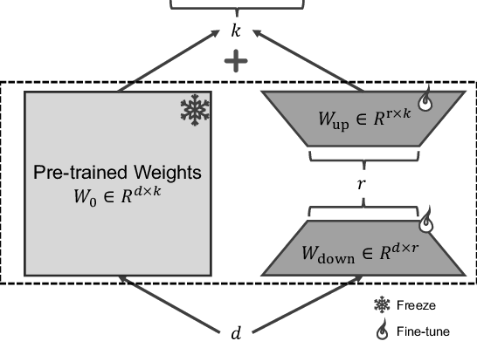
LORA -> Low Rank Adaptation
𝑊 is the original pretrained weight matrix
𝐴 and 𝐵 are new trainable matrices, usually initialized to very small values (often zeros for 𝐵 and random for 𝐴), so the model starts behaving like the original 𝑊 at the beginning.
During fine-tuning, 𝐴 and 𝐵 learn values that, when multiplied (𝐵⋅𝐴), produce an update matrix Δ𝑊 that is added to 𝑊
The model uses 𝑊+(𝐵⋅𝐴) instead of 𝑊 during training.
Back

Slide 47
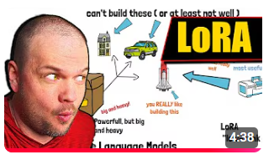
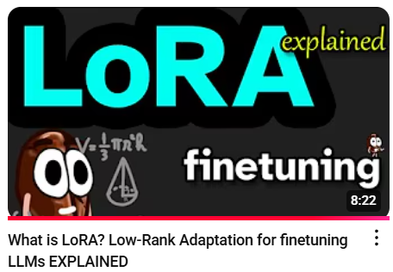
LoRA - Low-rank Adaption of AI Large Language Models:
LoRA and QLoRA Explained Simply
What is LoRA? Low-Rank Adaptation for finetuning LLMs EXPLAINED
Back

Slide 48
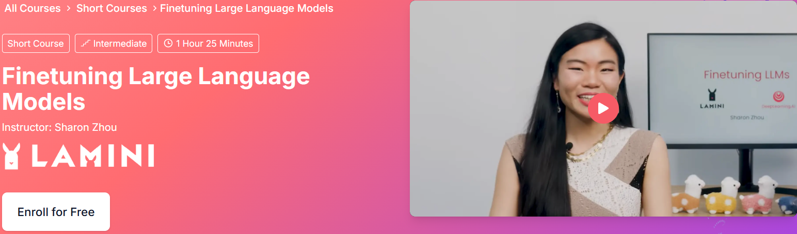
Finetuning Large Language Models

